Slide 1

Introduction To Association Rules

Slide 2
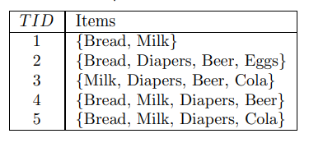

Customer purchase data generated daily at checkout counters of grocery stores.
Such transactions are known as market basket transactions
Each row has a transaction ID and the set of items bought by a customer
Can we utilize this data to understand the purchasing behavior of customers
Motivation
Market transactions
Notes:
Many businesses maintain a large amount of data from their
day to day operatiosn

Slide 3
Can help retailers develop marketing strategies by gaining insight into which items are frequently purchased together by customers.
If customers are buying milk, how likely are they to also buy bread in the same trip
Help retailers understand the shelf space, marketing promotions, inventory management, customer relationship management
“Which groups or sets of items are customers likely to purchase on a given trip to the store?”
Motivation
Market transactions
Notes:
To answer your question, market basket analysis may be performed on the retail data of customer transactions at your store. You can then use the results to plan marketing or advertising strategies, or in the design of a new catalog. For instance, market basket analysis may help you design different store layouts. In one strategy, items that are frequently purchased together can be placed in proximity to further encourage the combined sale of such items. If customers who purchase computers also tend to buy antivirus software at the same time, then placing the hardware display close to the software display may help increase the sales of both items.
In an alternative strategy, placing hardware and software at opposite ends of the store may entice customers who purchase such items to pick up other items along the way. For instance, after deciding on an expensive computer, a customer may observe security systems for sale while heading toward the software display to purchase antivirus software, and may decide to purchase a home security system as well. Market basket analysis can also help retailers plan which items to put on sale at reduced prices.
If customers tend to purchase computers and printers together, then having a sale on printers may encourage the sale of printers as well as computers

Slide 4
In a store, all vegetables are placed in the same aisle, all dairy items are placed together and cosmetics form another set of such groups.
Investing time and resources on deliberate product placements like this not only reduces a customer’s shopping time,
but also reminds the customer of what relevant items (s)he might be interested in buying, thus helping stores cross-sell in the process.
Association rules help uncover all such relationships between items from huge databases.
Example
Of
Association
Rules
Notes:
Person who buy

Slide 5

What is Association Rule ?
The transaction data can be analyzed for buying patterns that reflect items that are frequently associated or purchased together.
These patterns can be represented in the form of association rules.
Association Rules analysis is a technique to uncover how items are associated to each other.
Association rule mining can help to automatically discover regular patterns, associations, and correlations in the data.

Slide 6
Association Rule - Terminologies
An association rule has 2 parts:
an antecedent (if) and
a consequent (then)
An antecedent is something that’s found in data, and a consequent is an item that is found in combination with the antecedent.
Eg: If a customer buys bread, then he’s 60% likely of buying milk.”
In the above association rule, bread is the antecedent and milk is the consequent.
This can be understood as a retail store’s association rule to target their customers better. Need is to derive such rules from the analysis of datasets
Unlike the if-then rules of logic, association rules are probabilistic in nature.
.
Notes:
a thing that existed before or logically precedes another:
Previous or preexisting

Slide 7
Association Rule - Terminologies
In addition to the Antecedent (if) and the Consequent (then), an association rule has two numbers that express the degree of uncertainty about the rule.
The usefulness and certainty of discovered rules is defined by the following parameters:
Support: Support indicates how frequently the if/then relationship appears in the database.
Confidence: Confidence tells about the number of times these relationships have been found to be true.
For example, the information that customers who purchase Milk also tend to buy Bread at the same time is represented in the following association rule:
Milk ⇒ Bread [support = 60 %, confidence = 75%].
Notes:
a thing that existed before or logically precedes another:
Previous or preexisting

Slide 8
Support Confidence and Lift
For example, the information that customers who purchase Milk also tend to buy Bread at the same time is represented in the following association rule:
Milk ⇒ Bread [support = 60%, confidence = 75%].
A support of 60% for Rule means that 60% of all the transactions under analysis show that Milk and Bread are purchased together (3/5). Generally support will be a small value
A confidence of 75% means that 75% of the customers who purchased Milk also bought Bread (3/4)
Typically, association rules are considered interesting if they satisfy both a minimum support threshold and a minimum confidence threshold. These thresholds can be a set by users or domain experts.
Notes:
a thing that existed before or logically precedes another:
Previous or preexisting

Slide 9

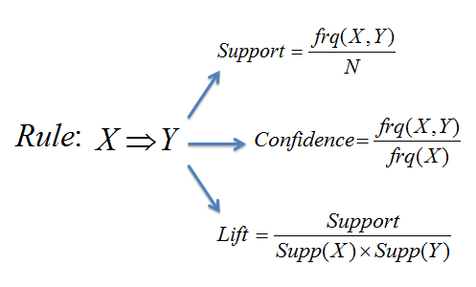
Association Rules
Find all sets of items (item sets) that have support greater than the minimum support and then using the large item sets to generate the desired rules that have confidence greater than the minimum confidence.
The lift of a rule is the ratio of the observed support to that expected if X and Y were independent.

Slide 10
Why Support and Confidence
Support is an important measure because a rule that has very low support may occur simply by chance.
Will not be interesting from a business perspective because it may not be profitable to promote items that customers seldom buy
Support helps to eliminate uninteresting rules
Confidence measures the reliability of the inference made by the rule.
For a given rule X→ Y higher the confidence, more likely it is for Y to be present in transactions that contain X.
Notes:
a thing that existed before or logically precedes another:
Previous or preexisting

Slide 11
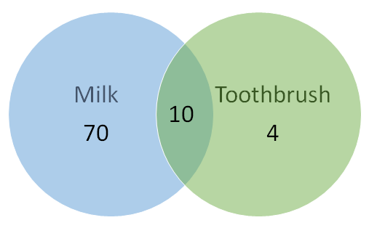
Confidence and Lift
Confidence for {Toothbrush} → {Milk} will be 10/(10+4) = 0.7. Looks like a high confidence value. But we know intuitively that these two products have a weak association and there is something misleading about this high confidence value.
Lift is introduced to overcome this challenge.
Probability of having milk on the cart with the knowledge that toothbrush is present (i.e. confidence) : 10/(10+4) = 0.7.
Consider the probability of having milk on the cart without any knowledge about toothbrush: 80/84 = 0.95
Lift = (10/14)/(80/84) = 0.75, confidence/supp{Milk}
Notes:
A lift value greater than 1 indicates that the rule body and the rule head appear more often together than expected, this means that the occurrence of the rule body has a positive effect on the occurrence of the rule head.
A lift smaller than 1 indicates that the rule body and the rule head appear less often together than expected, this means that the occurrence of the rule body has a negative effect on the occurrence of the rule head.
A lift value near 1 indicates that the rule body and the rule head appear almost as often together as expected, this means that the occurrence of the rule body has almost no effect on the occurrence of the rule head.

Slide 12
Lift Interpretation
Lift = (10/14)/(80/84) = 0.75, confidence/supp{Milk}
A lift smaller than 1 indicates that the Y and the X appear less often together than expected
A lift greater than 1 indicates that the Y and the X appear more often together than expected
A lift equal to 1 indicates that the Y and the X appear together as often as expected, occurrence of X has almost no effect on the occurrence of Y
Notes:
A lift value greater than 1 indicates that the rule body and the rule head appear more often together than expected, this means that the occurrence of the rule body has a positive effect on the occurrence of the rule head.
A lift smaller than 1 indicates that the rule body and the rule head appear less often together than expected, this means that the occurrence of the rule body has a negative effect on the occurrence of the rule head.
A lift value near 1 indicates that the rule body and the rule head appear almost as often together as expected, this means that the occurrence of the rule body has almost no effect on the occurrence of the rule head.

Slide 13
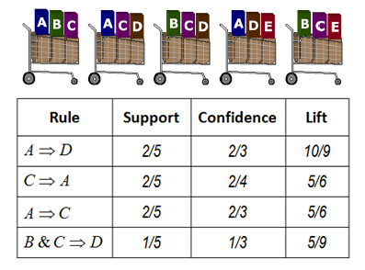
Example: Support, Confidence, Lift

Slide 14
Apriori Algorithm
The Apriori algorithm is used for mining frequent item sets and devising association rules from a transactional database.
The parameters “support” and “confidence” are used. Support refers to items’ frequency of occurrence; confidence is a conditional probability.
The Apriori algorithm takes advantage of the fact that any subset of a frequent item set is also a frequent item set.
The algorithm can therefore, reduce the number of candidates being considered by only exploring the item sets whose support count is greater than the minimum support count. All infrequent item sets can be pruned if it has an infrequent subset.

Slide 15
Apriori Algorithm
Association rule mining can be viewed as a two-step process:
1. Find all frequent itemsets: By definition, each of these itemsets will occur at least as
frequently as a predetermined minimum support count, min sup.
2. Generate strong association rules from the frequent itemsets: By definition, these
rules must satisfy minimum support and minimum confidence..

Slide 16
Finding Frequent Itemsets
Calculate the support of item sets (of size k = 1) in the transactional database (note that support is the frequency of occurrence of an item set). This is called generating the candidate set. (C )
Prune the candidate set by eliminating items with a support less than the given threshold.
Join the frequent item sets to form sets of size k + 1, and repeat the above sets until no more item sets can be formed.
This will happen when the set(s) formed have a support less than​ the given support.

Slide 17
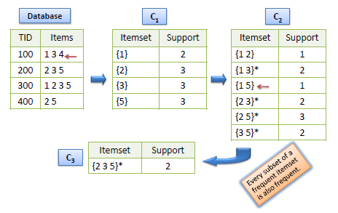
Finding Frequent Itemsets - Support
Candidate item sets are generated using only the large item sets of the previous pass without considering the transactions in the database.
The large item set of the previous pass is joined with itself to generate all item sets whose size is higher by 1.
Each generated item set that has a subset which is not large is deleted. The remaining item sets are the candidate ones.

Slide 18
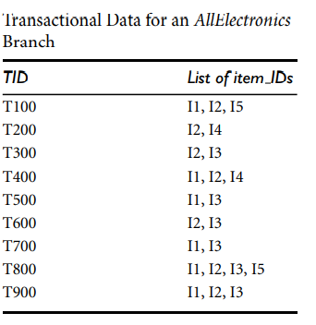
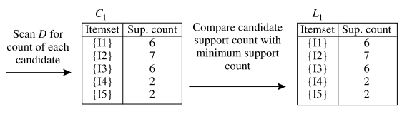
Example For Apriori Algorithm
Notes:
Candiaite Item sets and frequent item sets where minimum support is 2

Slide 19
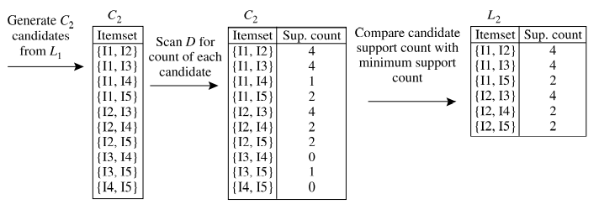
Generation of Frequent Item Set
Notes:
To discover the set of frequent 2-itemsets, L2, the algorithm uses the join L1 ✶ L1 to generate a candidate set of 2-itemsets,
C2 consists of LC2
Note that no candidates are removed from C2 during the prune step because each subset of the candidates is also frequent.

Slide 20
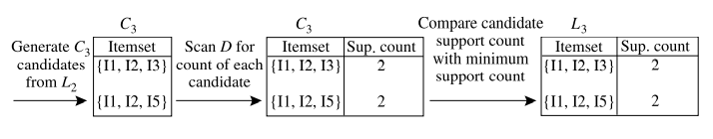
Generation of Frequent Item Set

Slide 21
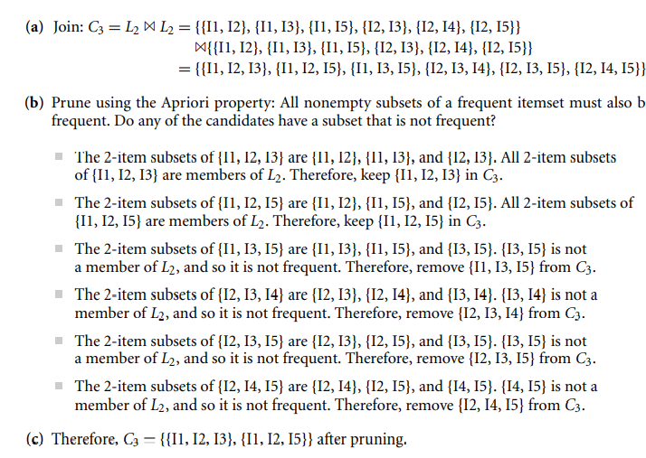
Pruning of candidate 3 Itemsets

Slide 22
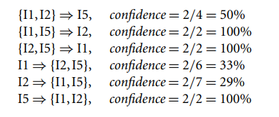
Generation of Association Rules
Once the frequent itemsets from transactions in a database D have been found, it is straightforward to generate strong association rules from them
The data contain frequent itemset X = {I1, I2, I5}. What are the association rules that can be generated from X? The nonempty subsets of X are {I1, I2}, {I1, I5}, {I2, I5}, {I1}, {I2}, and {I5}. The resulting association rules are as shown below, each listed with its confidence:
If the minimum confidence threshold is, say, 70%, then only the second, third, and last rules are output, because these are the only ones generated that are strong

Slide 23
Example For Apriori Algorithm
To begin with, divide the transactions into two categories: Groceries and Apparels.
After studying the data, following observations were noted in the groceries business unit:
• T2 Milk is bought as a single product in 2,461 transactions in the month of May 2018.
• T1 Milk is bought along with bread in 523,457 transactions in the month of May 2018.
 | ID | Item 1 | Item 2 | Number of Transactions In a Month
Groceries | T1 | Milk | Bread | 523,457
 | T2 | Milk | - | 2,461
Apparels | T1 | Jeans | Shoes | 198
 | T2 | Jeans | - | 29,846

Slide 24
Conclusions from the study for the Groceries Business Unit:
• When customers buy milk, they also buy bread along with it.
• Total transactions where milk is present = 523,457 + 2461 = 525,918
• Total transactions where milk and bread are present = 523,457
• The association or probability of customers buying bread given the fact that they buy milk is = 523,457/525,918 = 99%
• When customers buy milk, they also buy bread along with it.
There is association between milk and bread
Advantages
of
Random
Forests

Slide 25
Advantages
of
Random
Forests
• • There is no association between jeans and formal shoes.
• Total transactions in which jeans were present = 29,846 + 198 = 30,044
• Total transactions in which jeans and formal shoes were present = 198
• The association or probability of customers buying formal shoes given the fact that they buy jeans is = 198/30,44 = 1%

Slide 26

Thank you

